Slide 1
E-commerce Sales Data Analysis
Data Story Presentation Internship Project
SHREYA SRIVASTAVA

Slide 2
Problem Statement
Understanding sales performance
Finding factors affecting sales and profit
Identifying patterns in discount and sales
Providing business insights

Slide 3
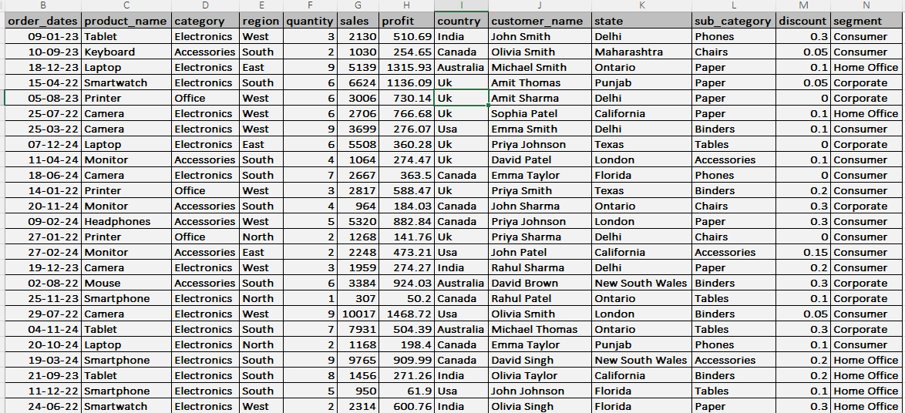
Dataset Overview
Dataset: E-commrece Sales Dataset
Columns:
Order_dates
Product_nam
Category
Region
Quantity
Sales
Profit
Country
Customernam
State
Sub_category
Discount
Segment
The dataset includes thousands of transactions, representing the company's business activities across multiple regions and product categories.

Slide 4
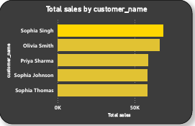
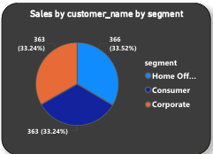
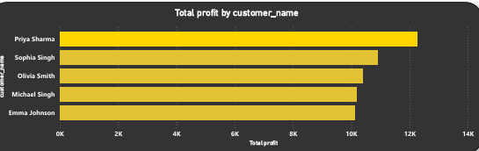
Customer Analysis
Customers belong to different segments
Home office segments contribute more orders
Sophia Singh was on top total sales by customer
Priya Sharma was top on Total profit by customer

Slide 5
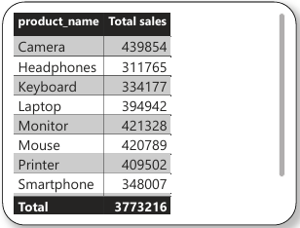
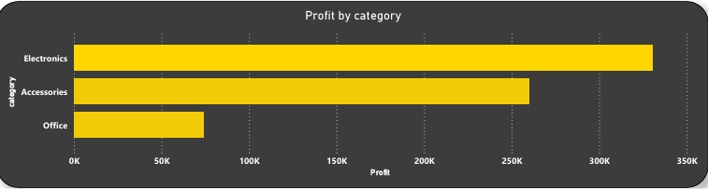
PRODUCT ANALYSIS
Category analysis helps identify top products
Product name and there total sales
Electronics product categories are more popular
And there total sale is 3773216.

Slide 6
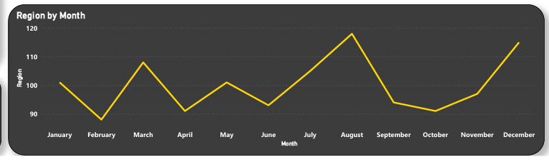
REGIONAL ANALYSIS
Customers are distributed across regions
Some regions show higher customer activity

Slide 7
Hypothesis Testing
Hypothesis
Providing discount increases sales
Analysis
Discount and sales relationship analyzed
Obervastion
Higher discount showed higher sales

Slide 8
Key Insights
Certain customer segments purchase more
Some regions generate higher orders
Product categories differ in performance
Top products drive revenue

Slide 9
Conclusion
Customer and product analysis helps understand business performance
Data insights support better decision making
Businesses can focus on high performing products

Slide 10
THANK YOU
Thank you for reviewing this data analysis presentation. This project analyzed customer and product data to identify patterns and insights that can support better business decisions.
I appreciate your time and feedback on this analysis.
SHREYA SRIVASTAVA
Data Analysis Internship Project

